Slide 1
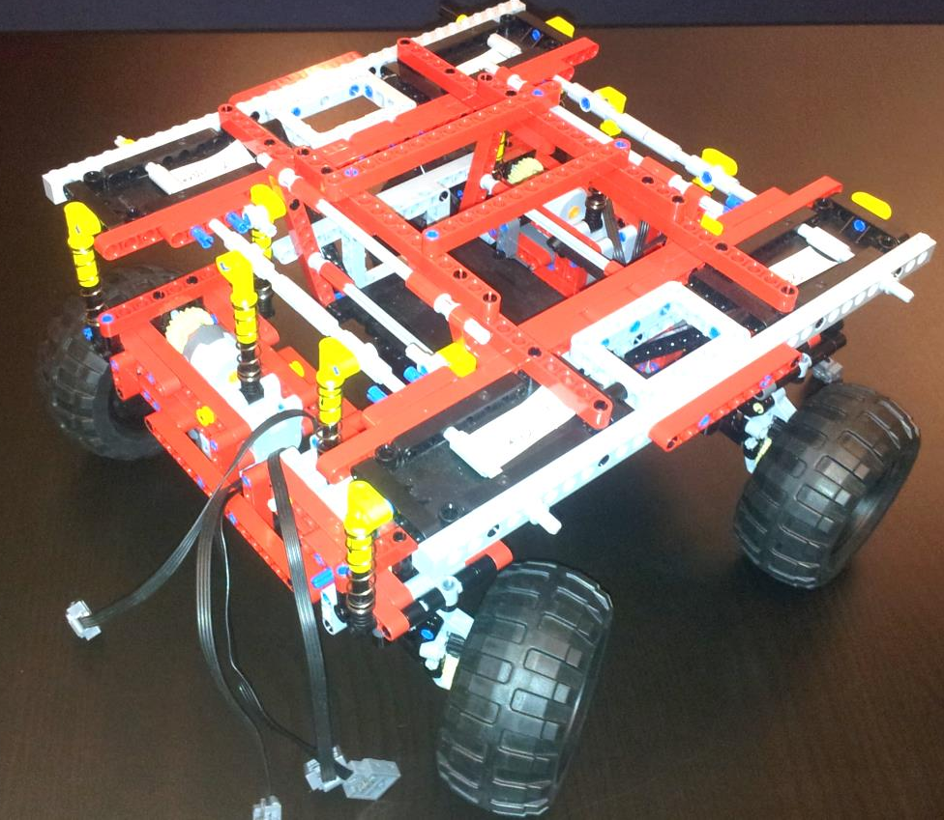
HW/SW Co-Design with a LEGO car
Group – LEGO 4 wheel 8 motors

Slide 2
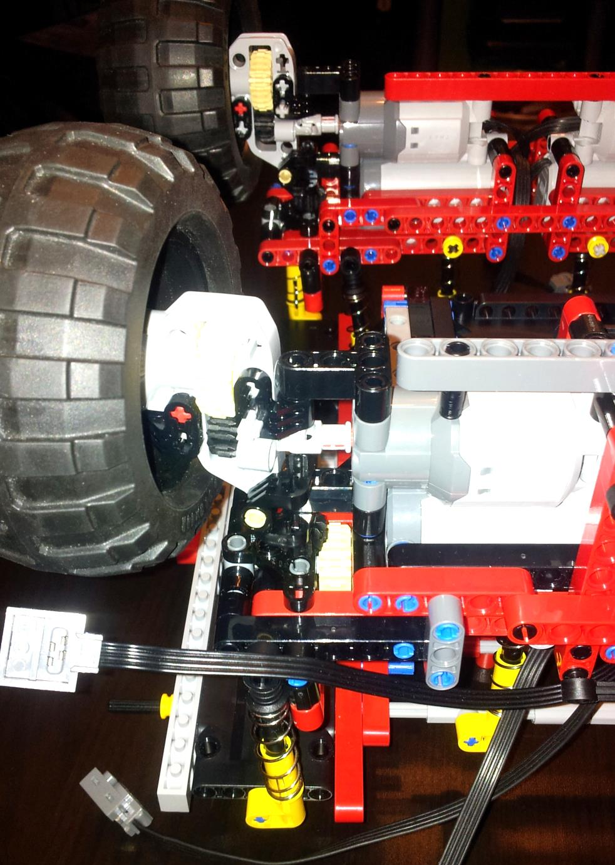
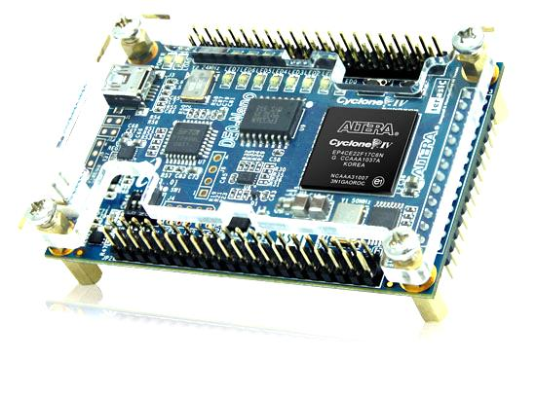
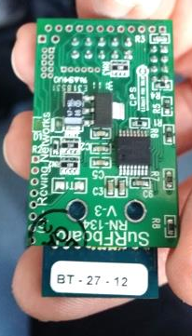
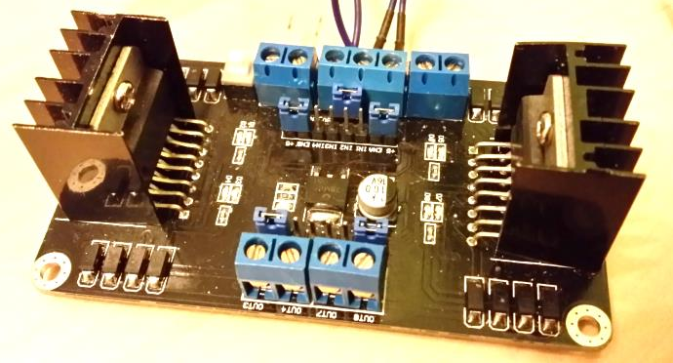
Initial position:
Prebuilt Lego-Car with 8 motors
-> 2 motors per wheel
DE0-Nano Board with FPGA
H-Bridge
WiFi Chip

Slide 3
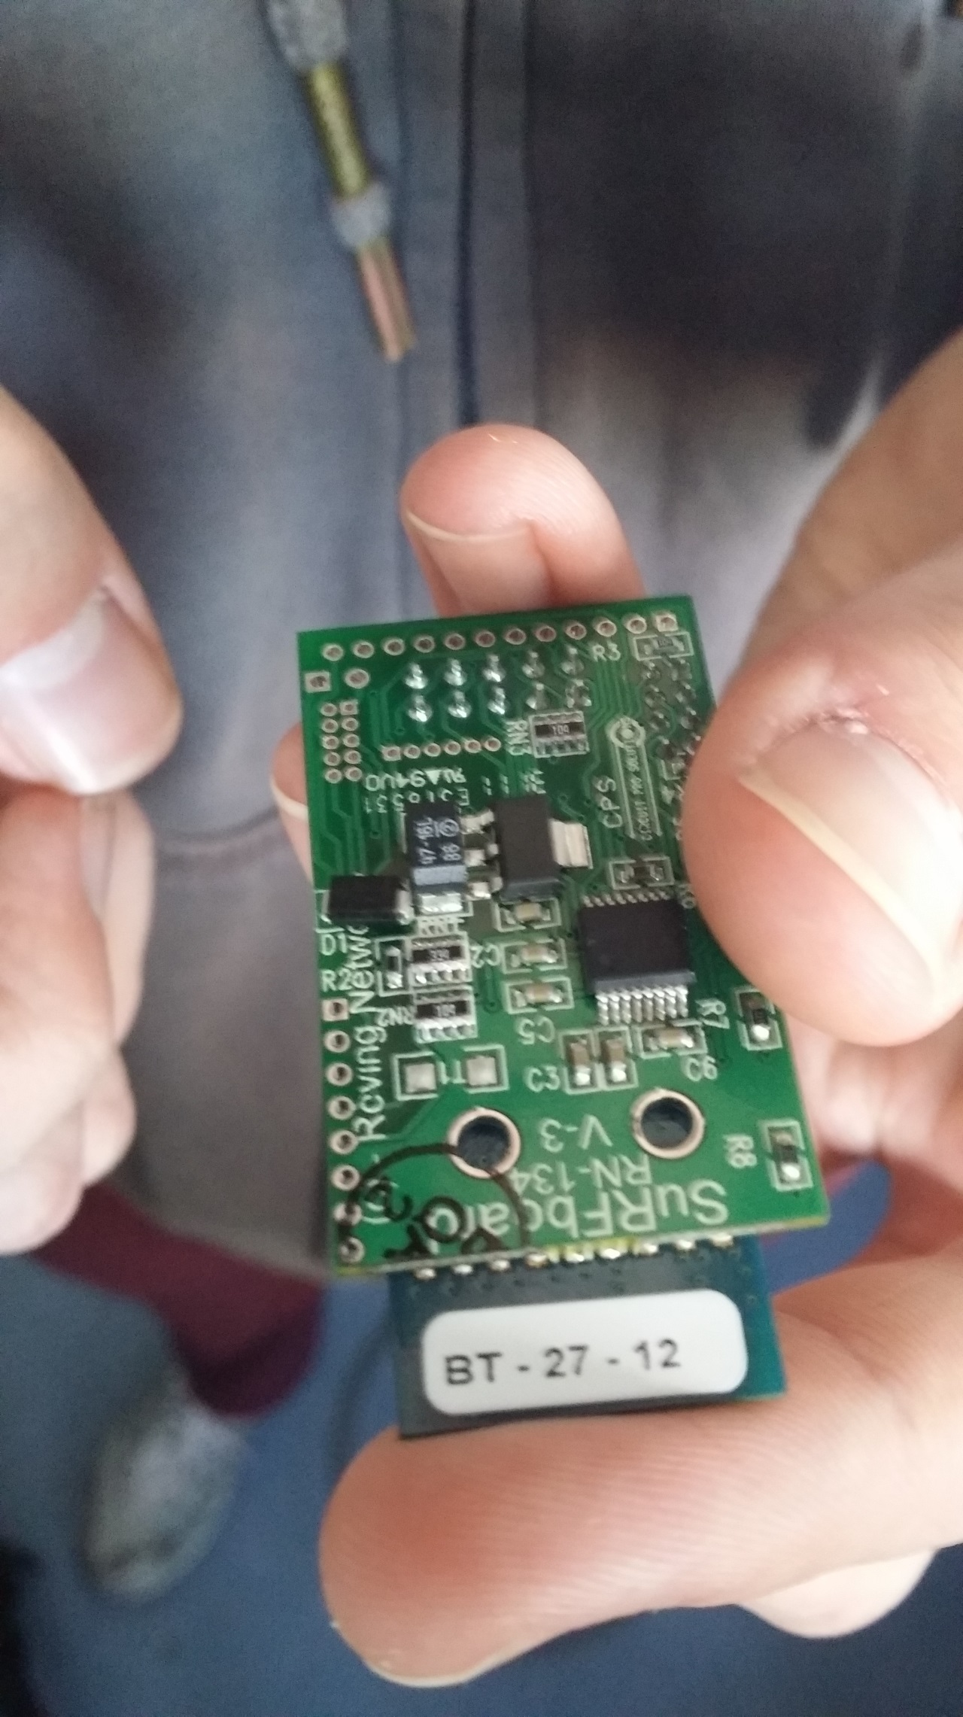
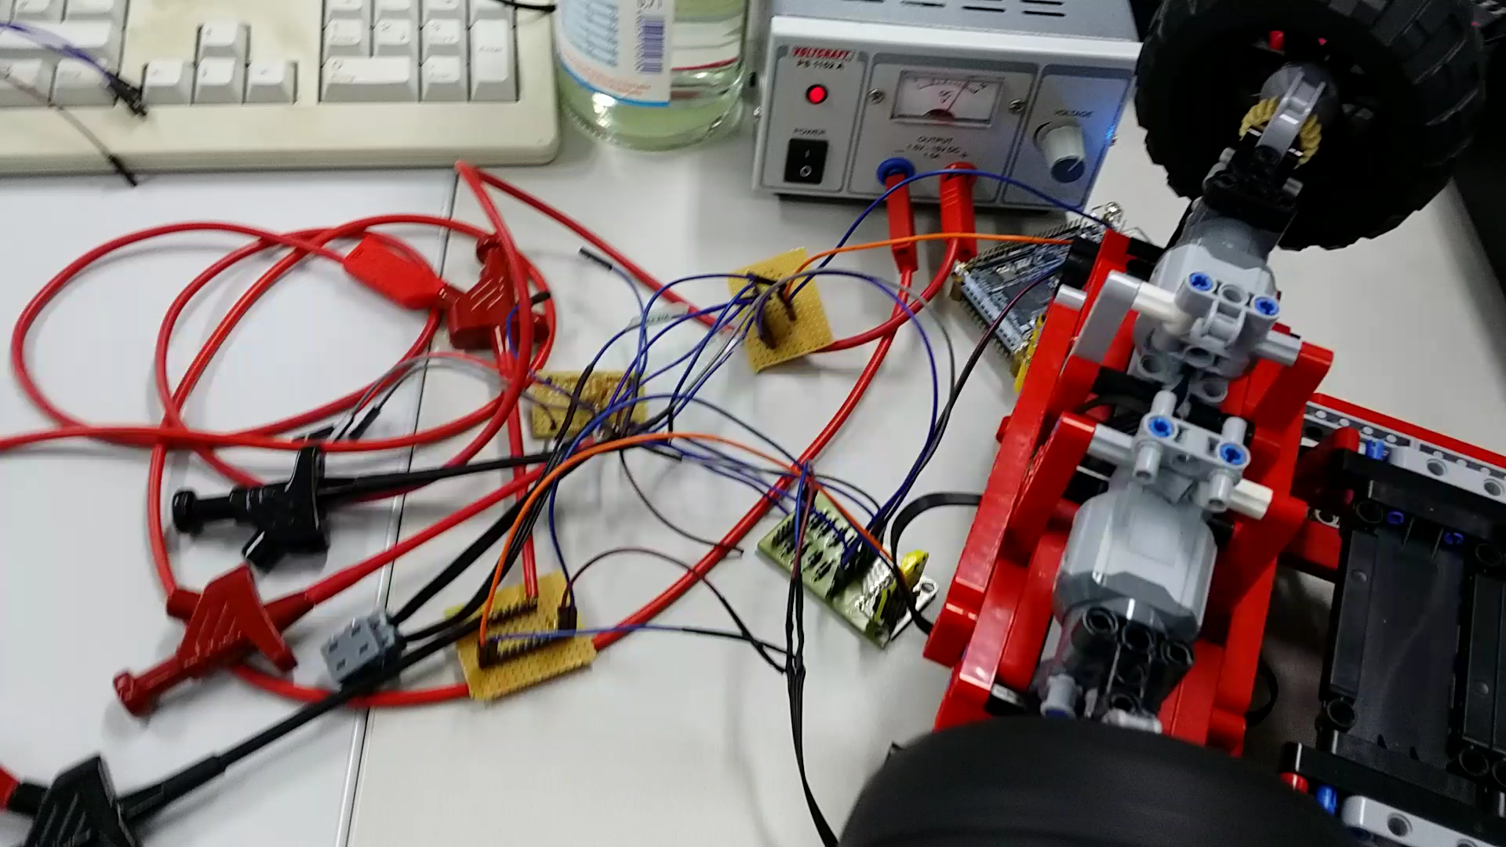
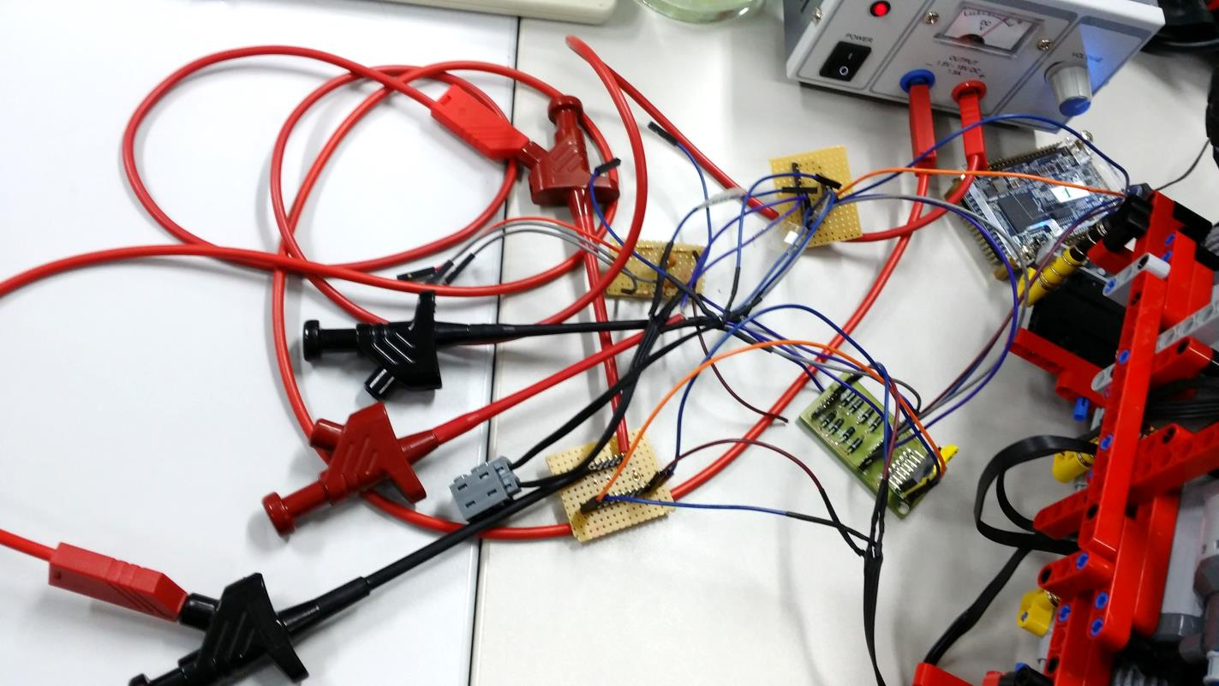
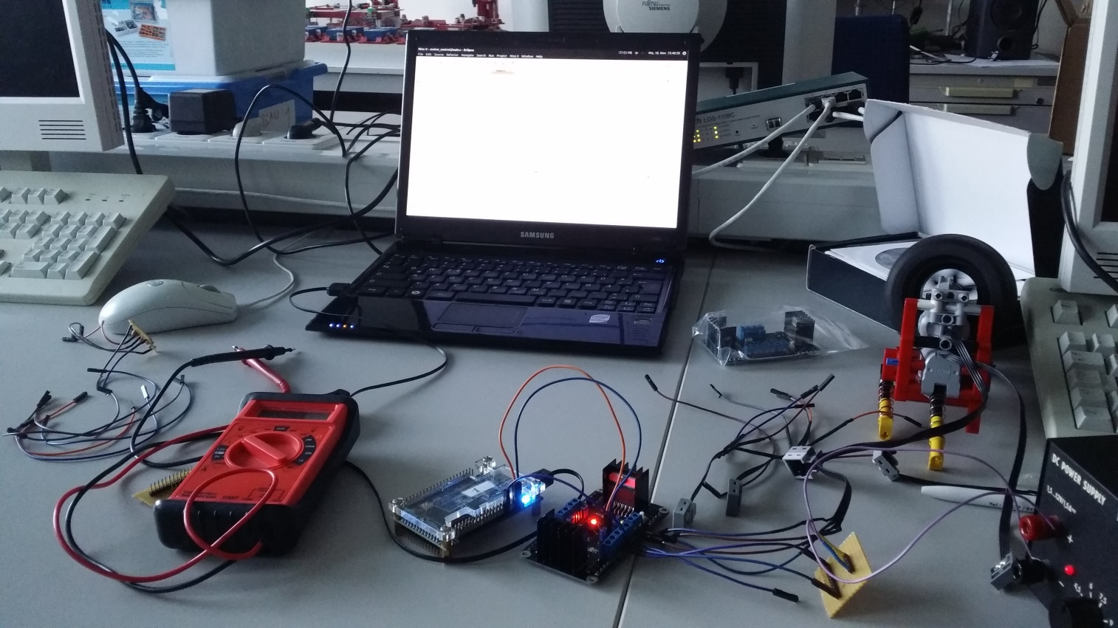
Problems:
Broken WiFi Chip
Lack of cables
Accomplishments:
Switched some gears for more sturdiness
Voltage control on one motor with FPGA

